Slide 1

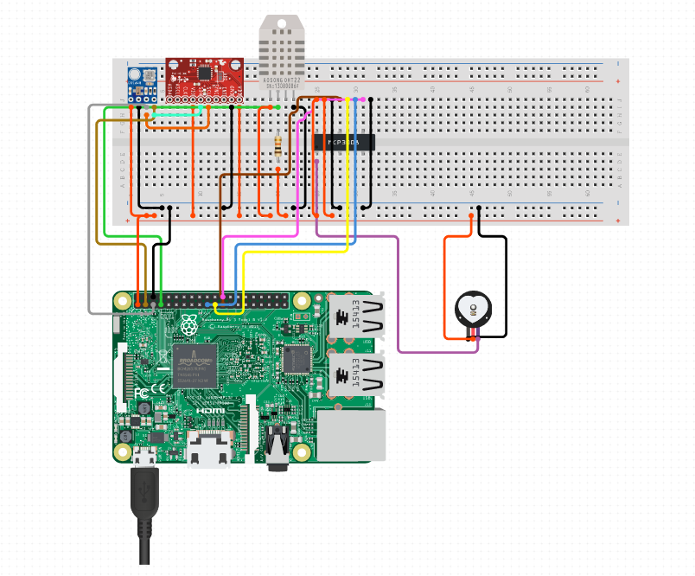
MPU-6050 - Accelerometer and Gyro
DHT22/11 Humidity and Temperature Sensor
BMP180 Barometric Pressure, Temperature, Altitude Sensor
BreadBoard
Heart Rate Pulse Sensor
Raspberry Pi 3 - Model B
Rpi Sensor Hub- Design Trial 0
Notes:
schematic diagram

Slide 2
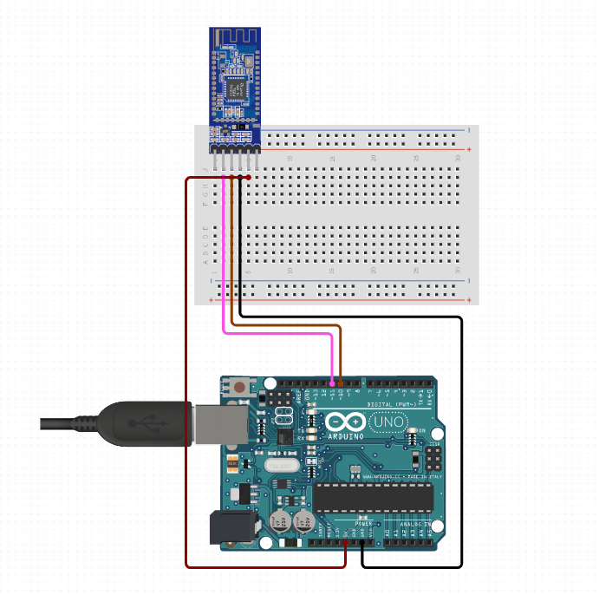
Bluetooth 4 (BLE) HM-10
BreadBoard - Half Size
Arduino Uno - R3
BLE Reciever

Slide 3
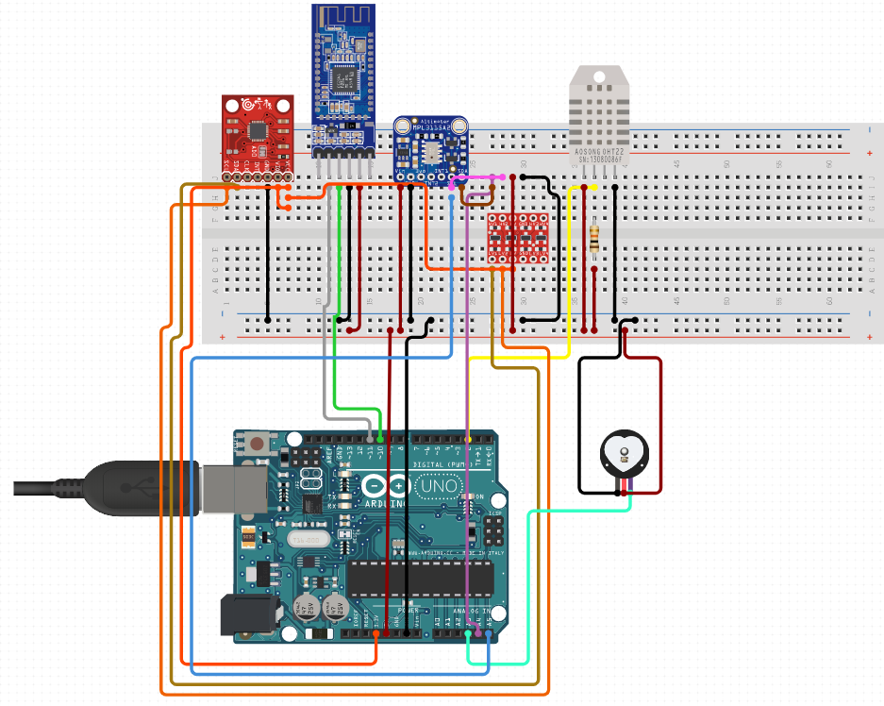
Bluetooth 4 (BLE) HM-10
MPU-6050 - Accelerometer and Gyro
DHT22/11 Humidity and Temperature Sensor
BMP180 Barometric Pressure, Temperature, Altitude Sensor
BreadBoard
Heart Rate Pulse Sensor
Arduino Board - Design Trial 1

Slide 4
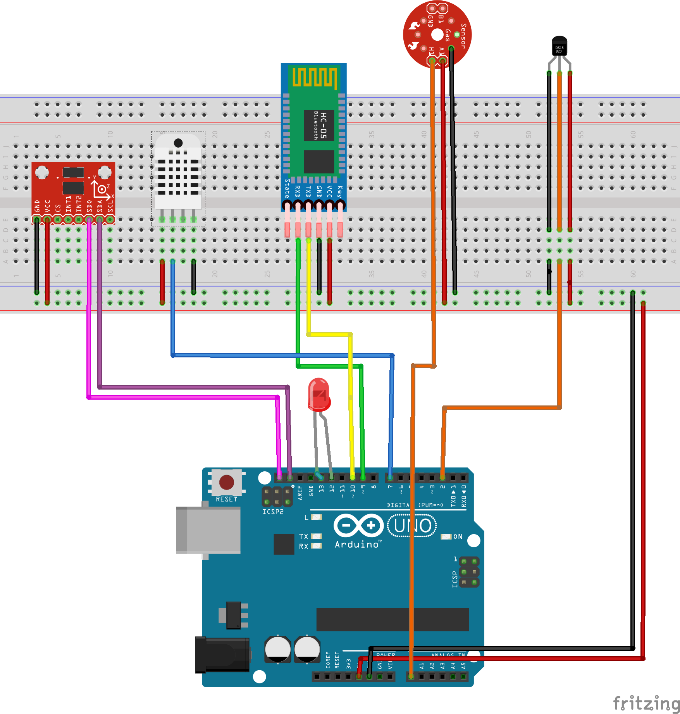
Final Design for Senor Hub Lab

Slide 5
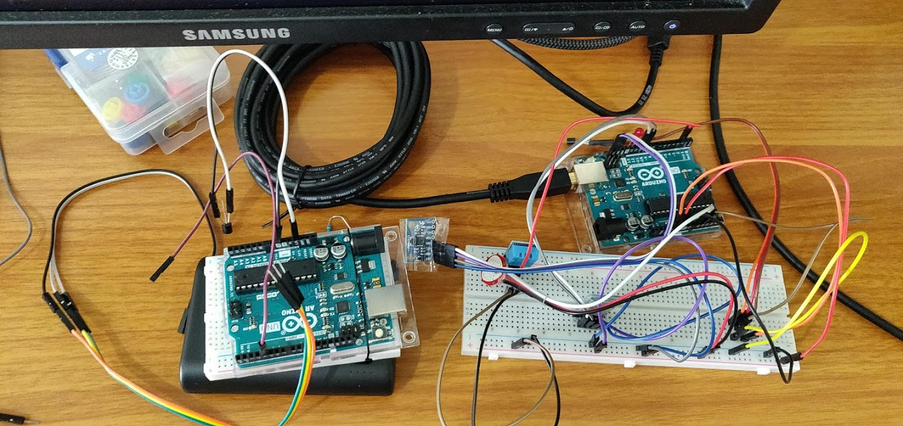
Final Design for Senor Hub Lab

Slide 6
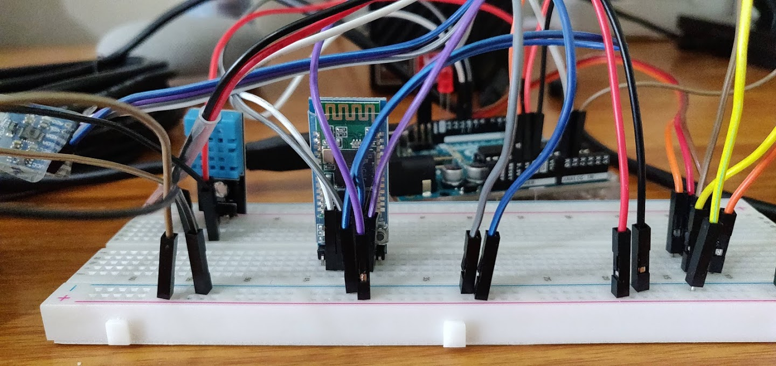
Final Design for Senor Hub Lab

Slide 7
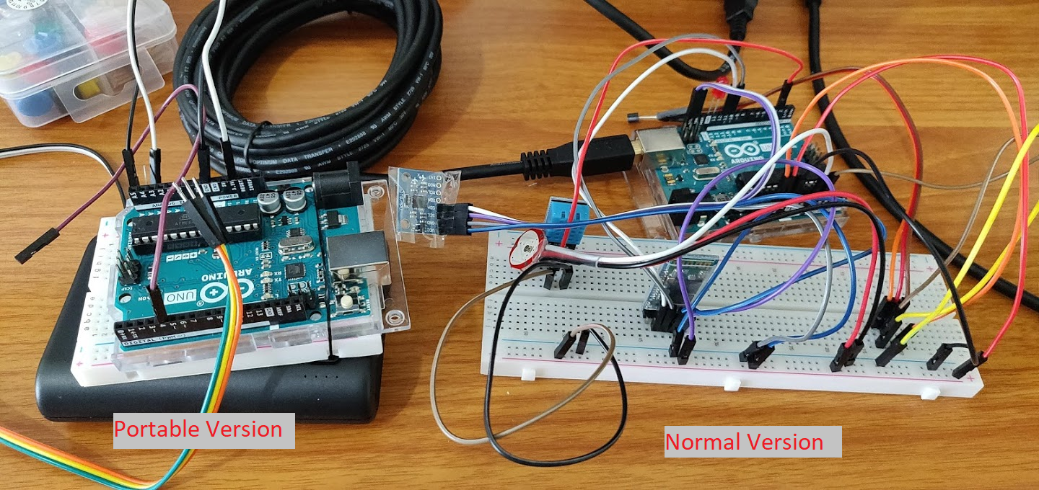
Final Design for Senor Hub Lab

Slide 8
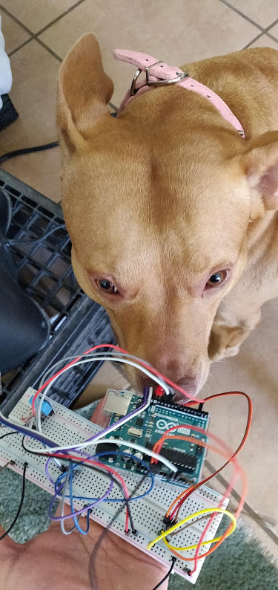
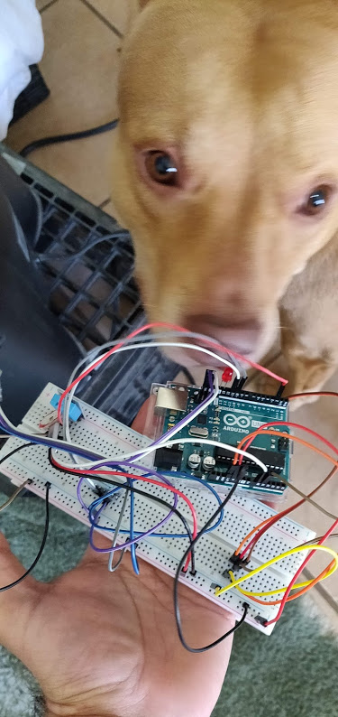
Board was properly tested by my personal tester Nyla

